Slide 1
This is a hidden slide
Dear honorable teacher please follow the instructions that has given in the slide notes (under the every slide). It would be helpful to take a successful class. Thanks a lot. I wish you good luck.

Slide 2
WELCOME

Slide 3
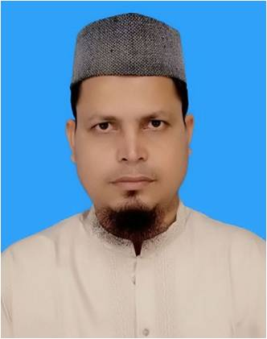
IDENTITY
SK. Md. Harunar Rashid
Senior Assist: Teacher
Sonatola Model High School,
Sonatola, Bogra.
Lesson
ENGLISH FOR TODAY
CLASS : SIX
UNI – 16

Slide 4
Let’s watch a video clip
Click here
Congratulation
What do we say to hear something good.
Notes:
Thise video will be shown for students mental preparation, to practise conversation.

Slide 5
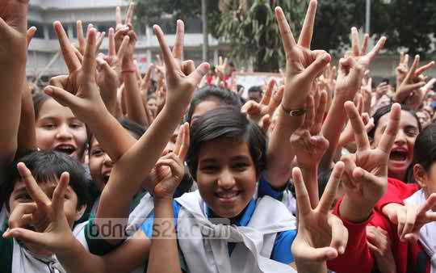
Look at the picture and talk with your partner what do we say to hear good news.
Hurrah ! We have got GPA 5.00
Congratulations to you ! You have well done !
Notes:
Teacher will try to elicit the answer from the SS then he/she will give feedback by animation.

Slide 6
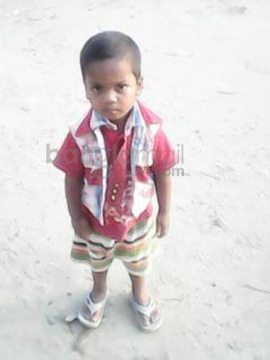
Look at the picture and talk with your partner what do we say to hear sad / bad news.
Alas ! Zihad has died.
That’s hard luck ! We are sorry to hear that.
Notes:
Teacher will try to elicit the answer from the SS then he/she will give feedback by animation.

Slide 7
Lesson declaration
So, Today we`ll discuss about -
Congratulations ! Well done !
Lesson : 2

Slide 8
Learning outcomes
After completing this lesson students will be able to-
read and understand written instructions
ask and answer questions
Participate in short dialogues and conversations on familiar topics.

Slide 9
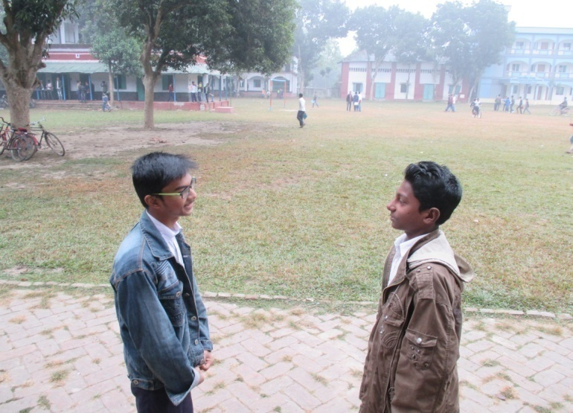
Follow the conversations
Hello, Nahid ! You look very happy today !
Oh, thanks ! Congratulations !
I am happy, I just heard that I have got Golden A+.
Thanks, Hridoy. I can’t tell you how happy I am !
Notes:
Here SS will only follow the conversation.

Slide 10
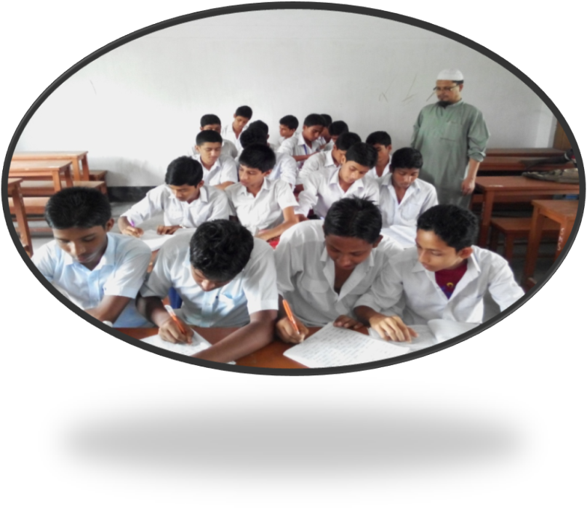
Presentation.
Go to section A there are three conversations. Read and discuss them carefully , then practise the conversations in pair.
Notes:
Teacher can ask 2/3 pairs infornt of class for practise.

Slide 11
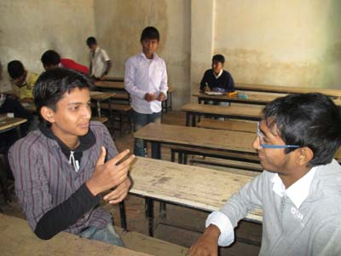
Pair works
Go to section B2 then answer the following questions by conversations in pairs. One is done for you.
I have won a lottery, so I am very happy today.
Oh, great ! Congratulations !
Thanks, See you again.
Hi, Saad ! You look very happy today.

Slide 12
Go to section A1. Discuss with your friends the meanings of : Generation, album, hit as they have been used in the conversations.
The words album and hit can be used in more than one meaning. Discuss in groups and see if you can guess the other meanings.
Generation
album
To know the meaning click on words.
album
hit
hit
Notes:
Teacher can make it easy by discussing then he/she will give some time to do the meaning. Later he/she will show the next slide for feedback.

Slide 13
Generation
Key word
Ist generation
2nd generation
3rd generation
Back
There are three generation here.
Meaning
(Click here)
‘Generation’ means -
The people of same age within a society.
Notes:
First, the word can be shown. The SS can be asked to pronounce the word. If it is needed teacher can help. Then the picture can be shown and asked to guess the meaning. For feedback click on meaning button. To go main menu click on back.

Slide 14
album
Key word
These are the most popular album of music.
‘Album’ means -
A CD or record that has several pieces of music on it.
Meaning
(Click here)
Notes:
First, the word can be shown. The SS can be asked to pronounce the word. If it is needed teacher can help. Then the picture can be shown and asked to guess the meaning. For feedback click on meaning button.

Slide 15
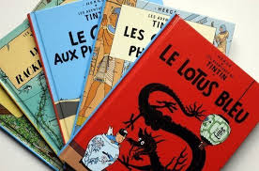
Album
Key word
Back
I have a beautiful photo album.
The other meaning of ‘Album’ is - a book with plain pages, typically used for collecting together and protecting stamps or photographs.
Meaning
(Click here)
Notes:
First, the word can be shown. The SS can be asked to pronounce the word. If it is needed teacher can help. Then the picture can be shown and asked to guess the meaning. For feedback click on meaning button. To go main menu click on back.

Slide 16
Hit
Key word
These albums are being hit in the market.
Meaning
(Click here)
Here ‘Hit’ means - Success
Notes:
After showing the meaning teacher will show the picture and asked the learners to make sentence then he/she will give feedback.

Slide 17
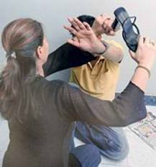
Hit
Key word
She is beating the noughty boy.
Meaning
(Click here)
The other meaning of ‘Hit’ is ‘to beat somebody.
Notes:
After showing the meaning teacher will show the picture and asked the learners to make sentence then he/she will give feedback.

Slide 18
Follow the conversation.
Now go to section B. read the conversation (ii) and (iii) then practise in pairs.
I had the flu. I was in bed most of the time.
I am all right now. Thanks.
Oh, I am sorry to hear that. How do you feel now ?
Hi, Saad ! Why didn’t you come to school last week ?
Notes:
Teacher can ask 2/3 pairs infornt of class for practise.

Slide 19
HOME WORK
Make a short conversation with your elder sister/brother about she/he has got GPA 5.00 in JSC examination 2014.

Slide 20
Acknowledgement
We would like to express our cordial gratitude to the Ministry of Education, Directorate of Secondary & Higher Education, NCTB, a2i
and
the panel of honorable editors ( Md. Jahangir Hasan, Associate Professor (English) TTC, Rangpur, Ranjit Poddar, Associate Professor (English) TTC, Dhaka, and Urmila Ahmed, Associate Professor (English) TTC, Dhaka, to enrich the contents.

Slide 21
THE END

